Slide 1

Time Series Regression on CO2 Emissions
KWAME DARko-Mensah, TEJDEEP REDDY meda, ANNAnya CHATTERJEE
DSCI 5340

Slide 2
RESEARCH
Research Design
This study aims to establish the trend of global CO2 over time.
This study will use data for the period between 2010-2019 for global CO2.
The data will be analyzed using MA, AR, ARMA and ARIMA models which are time series properties.
SAS software will be used for the purposes of statistical analyses.
Data Collection Technique
This study adopted the use of secondary data as an approach to establish global CO2 trend for the period 2010 to 2019.
Global CO2 data was accessed from world bank website
https://data.worldbank.org/indicator/EN.ATM.CO2E.PC?view=chart
Model Specification
A linear regression model was applied to establish the global CO2 trend through use of SAS.
The regression model below was used in determining the relationship between; time and global CO2
Yi =β0+βx1+εt
Where;
Y_{i}₌ Dependent variable (CO2)
β₀ ₌ The constant
εt₌ Error term
β1₌ Change included in Y by each ꭗ
T₁₌ Time t

Slide 3
WORKING HYPOTHESIS AND ANALYSIS
Working Hypothesis
H0: Global CO2 levels does not increases over time t
H1: Global CO2 levels increase over time t
This model focused on establishing possibility of predicting future relationship between time and levels of global CO2.
Regression analysis
Through linear regression, a function between the levels of global CO2 and time was developed to predict the future relationship between the CO2 and time.

Slide 4
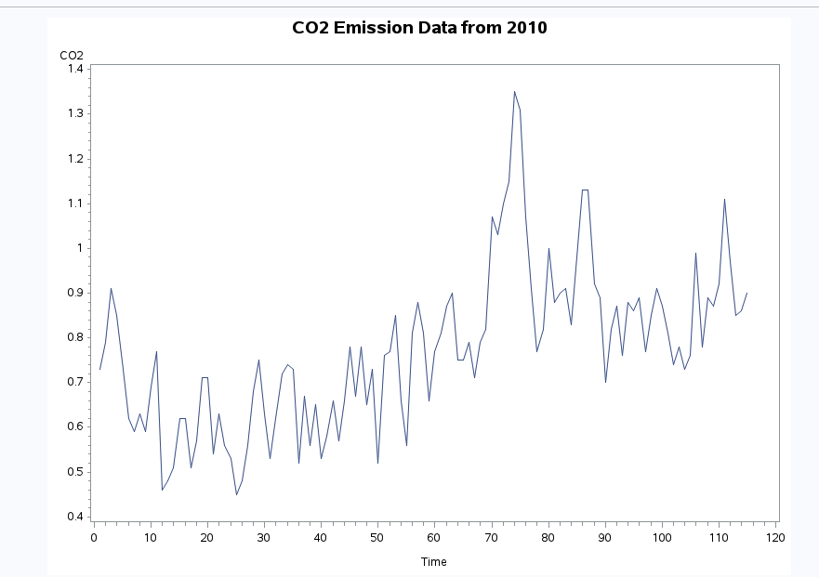
CO2 LINEAR REGRESSION MODEL
Graph Co2 over time whereby CO2 is the dependent variable and time is the independent variable.
There is an increasing trend of CO2 over time.
The trend can be said to be growing exponentially over time.
To carry out ARIMA models we need stationary data model meaning that observations are independent of time

Slide 5
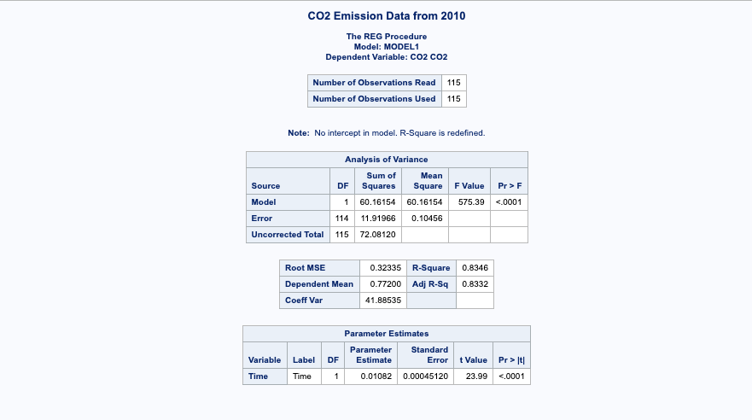
CO2 MODEL NO INTERCEPT
Parameter estimate β0=0.01082+εt=yt. If less than alpha (0.0001) we reject null Hypothesis. The summary shows a linear regression of CO2 emissions vs time. The p-value(<0.05) suggests that the model is significant. The model also defines 83% of the variability in data(R-square=0.8346).

Slide 6
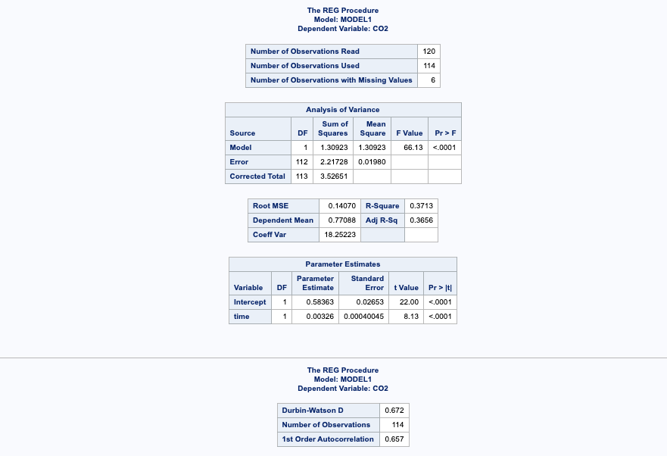
MODEL WITH INTERCEPT FOR DURBIN WATSON TEST
With Durbin-Watson D between 0-2 means, we can say there is evidence of positive auto correlation at 66% of 1st order autocorrelation.

Slide 7
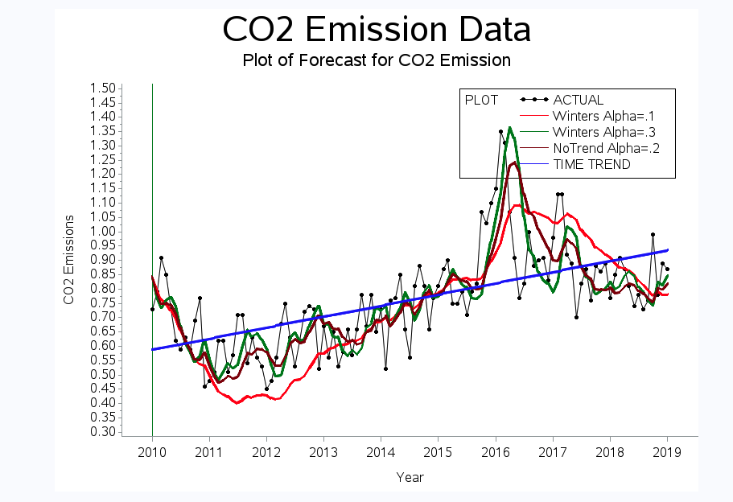
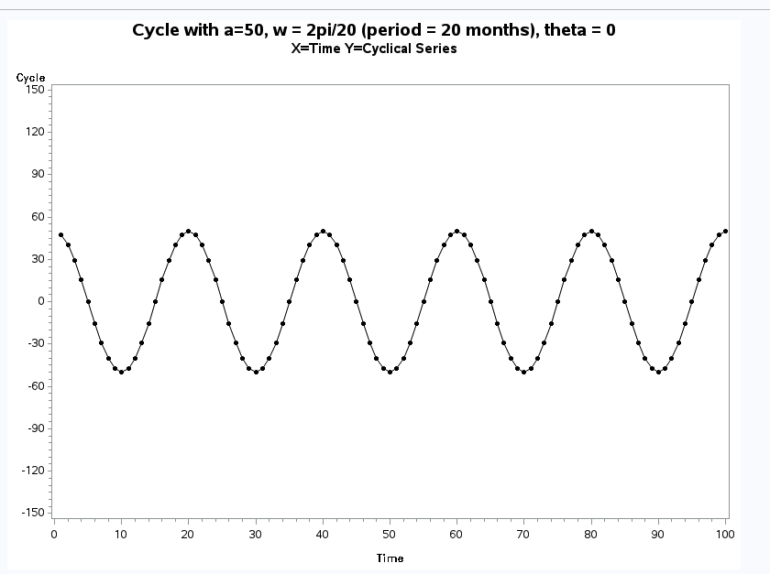
HOLTS METHOD FOR SMOOTHING OUR DATA-Trend(YES) SEASONALITY(NO)

Slide 8
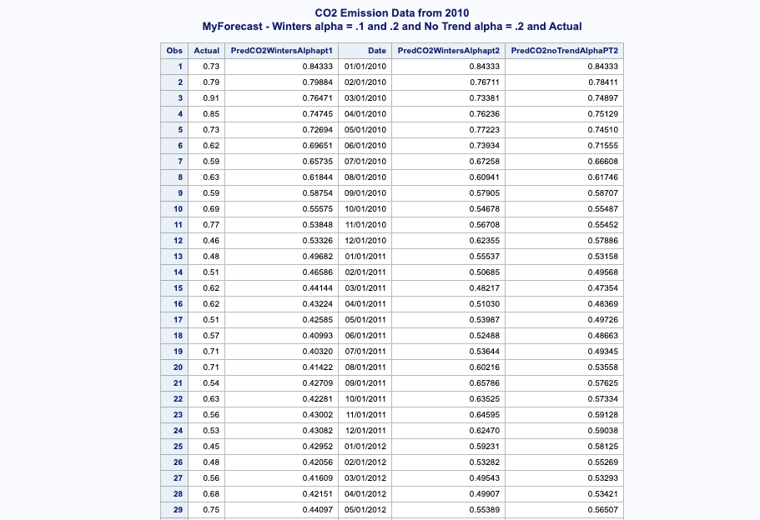
HOLTS METHOD FORECAST FOR DATA

Slide 9
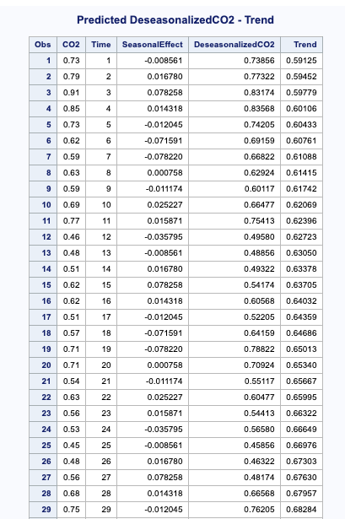
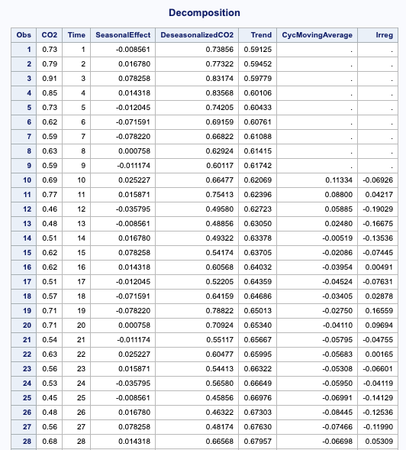
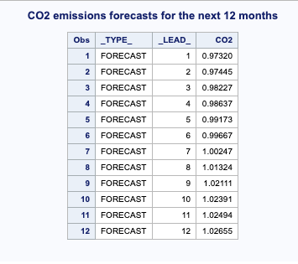
DECOMPOSITION OF THE DATA
Decomposition of the data also we can see trend and forecast of CO2 emissions for the next 12 months for the data after the process.

Slide 10
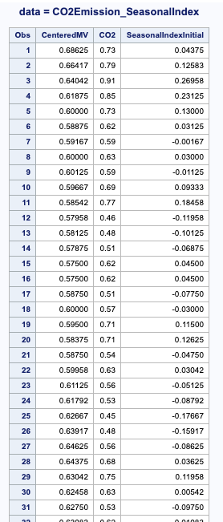
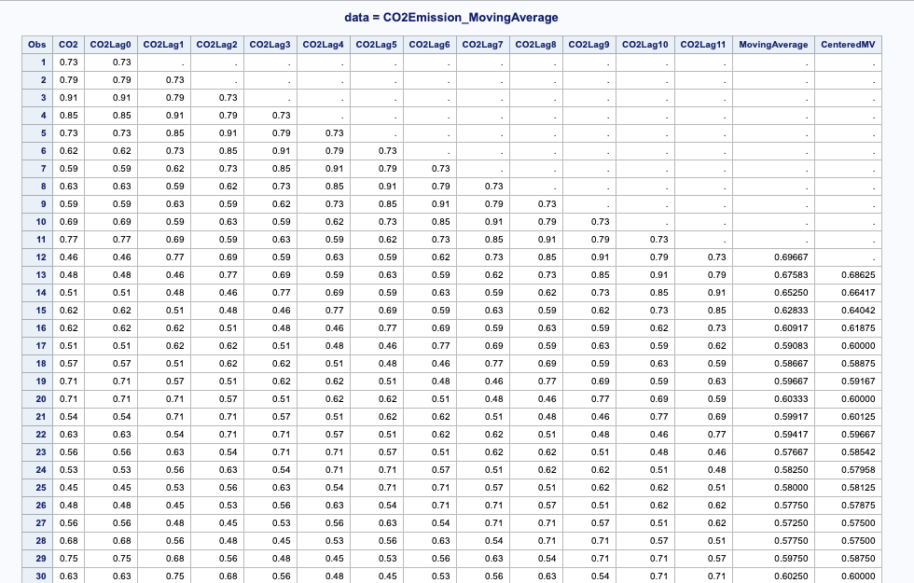
USING ADDITIVE MODEL FOR TREND
Results from SAS after using the additive method to see moving averages across observations and different lags for our data. This is an additional step to build the data up for modelling to see the best fit.

Slide 11
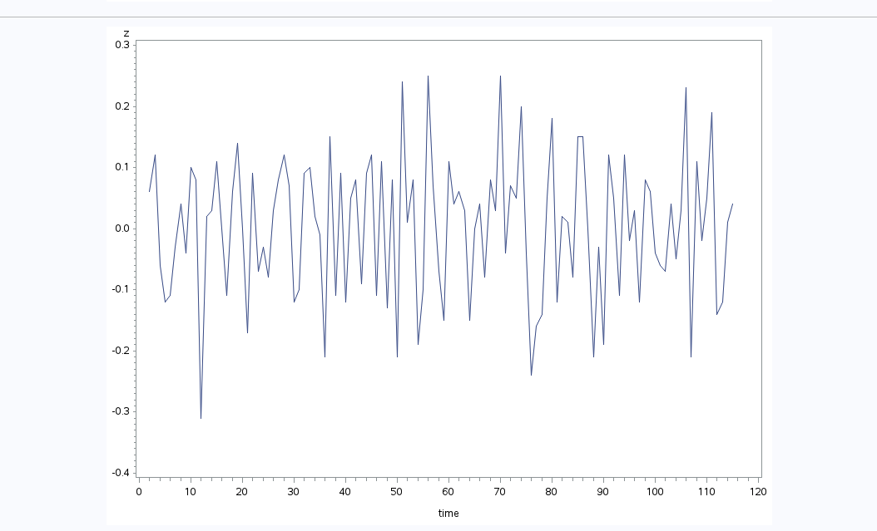
TIME SERIES MODEL ON OUR DATA- SHOWS STATIONARITY

Slide 12
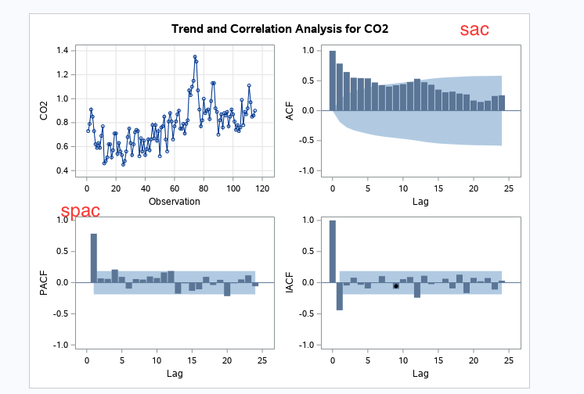
USING ARIMA RESULTS ACF AND PACF TO CHECK TRUE STATIONARITY

Slide 13
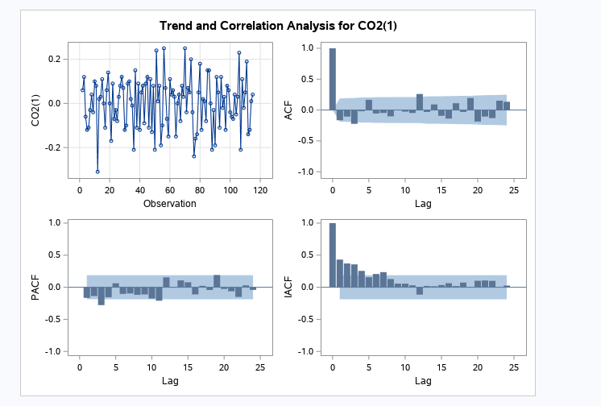

DIFFERENCING TO CREATE STATIONARITY RESULTS AND ADF TEST
The partial autocorrelation sketch is up to the third lag and cuts off or dies down after.

Slide 14

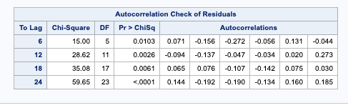
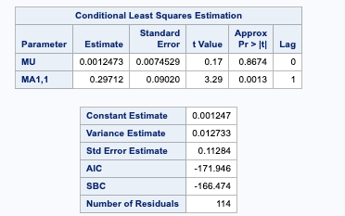
ESTIMATING WITH MA (1) MODEL WITH AND WITHOUT CONSTANT
In this MA model we look at the L-Jungs test of Pvalues to check for adequacy of the model. With the Pvalues all being less than alpha(α). This model will be inadequate.
We see high AIC and SBC of -173 and -171 as comparing to other models

Slide 15
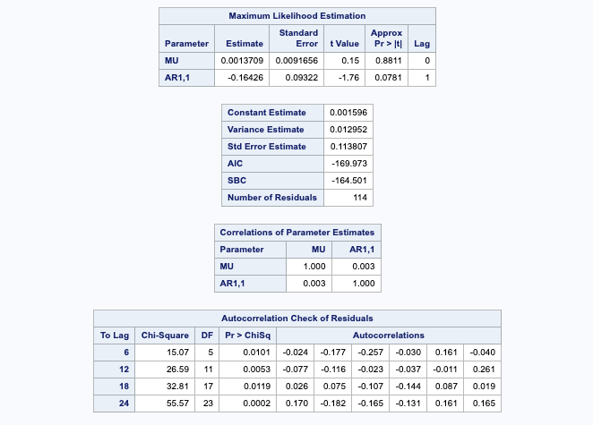
ESTIMATING USING ARIMA (1,1) AR(1) model
MU which is the mean term constant value of 0.0013709 and the t value of 0.15 adds little to the model. AR 1,1 the coefficient of the lagged value is -0.16426. Standard Error of 0.113807. AIC of -169.97. We see no strong correlation between independent variables. Using the L-Jungs test for this model, P values all less than alpha makes this model inadequate and not fit for this series.

Slide 16
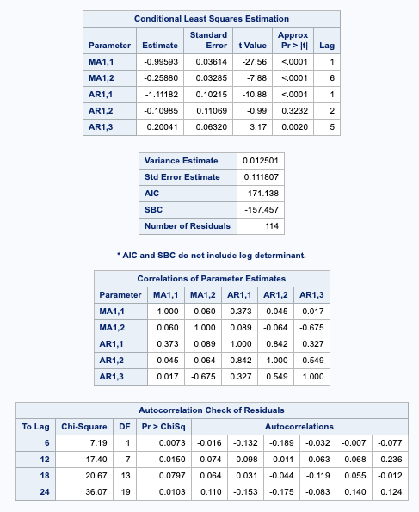
USING AUTO REGRESSIVE MOVING AVERAGE (ARMA) MODEL (2,3)
In this next model we will be looking at the ARMA model with our data set for time series regression assuming Looking at another ARMA Model (2,3)-Lag 1,2,5 and lag 1,6 for p and q
Looking at the results for this model. ARMA this is better than the MA model but not AR model looking at AIC, standard of error, however, it does not pass the adequacy test according to J-Lungs test as Pvalue at lag 6 is 0.0073 which is less than alpha (0.05). Therefore, this AR model is still inadequate since less than alpha.

Slide 17
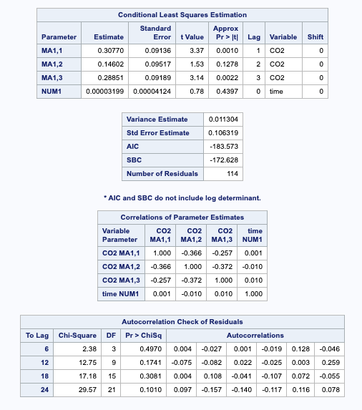

ESTIMATING AN MA MODEL MA(3) considers the change in CO2 as an average vs the AR model after improving data with additive model version of smoothing
With q=3 lag 1-2-3
The moving-averageMA1,1 and MA1,2 parameters 1,2 have significant t values. the variance estimate, AIC, and SBC are all smaller than they were for the MA(1) model of -183.57 and -172. and a smaller standard of error of 0.1068, indicating that the model fits the data better without over-parameterizing. Also when we use the L-Jungs check for accuracy, we see the pvalues at lag 6 is 0.497 thus, higher than α(alpha) of 0.05. Checking multicollinearity in this model we do not see any strong relationship between independent variables of .90+.

Slide 18
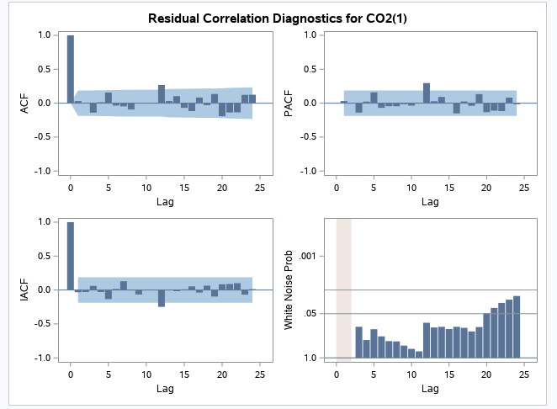
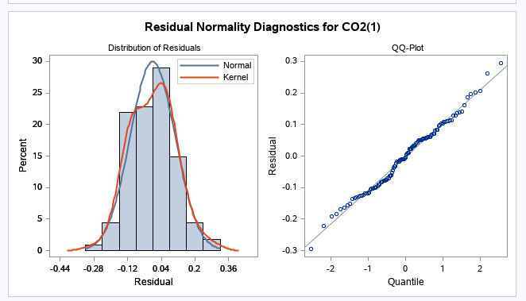
WHITE NOISE AND RESIDUAL PLOTS
the residual correlation and white noise test plots show that you cannot reject the hypothesis that the residuals are uncorrelated. The normality plots also show no departure from normality. Thus, you conclude that the MA model is adequate for the change in CO2 emissions series, and this is the best model for our data set.

Slide 19
ANALYSIS OF RESULTS
H_{0:} CO2=0
H_{1:} CO2 is not equal to zero
The moving average has a p-value of <0.0001 which is less than 0.05 level of significance, therefore moving average term is statistically significant and should be used in the model.
H_{0:} Time=0
H_{1:} Time is not equal to zero
Time has a p-value of <0.0001 which is less than 0.05 level of significance, therefore we reject null hypothesis and use alternative hypothesis. Time is statistically significant in predicting CO2
R-squared indicates that 37% of the errors in the model.
The predictive model for CO2 therefore becomes
Yi = β0+β1t1+εt
CO2= 1 - 0.3076 B**(1) - 0.14583 B**(2) - 0.28798 B**(3)

Slide 20
SUMMARY AND RECOMMENDATIONS
The purpose of this study was to create predictive model of global Co2 to provide a guideline for policy formulation.
Statistical analysis revealed that there is linear relationship between time and Co2 emissions.
The best predictive model; CO2= 1 - 0.3076 B**(1) - 0.14583 B**(2) - 0.28798 B**(3)
The main policy recommendation for the policy makers is to come up with policies which will ensure minimum Co2 emissions.

